Slide 1




Diving Deeper into Networking

Slide 2

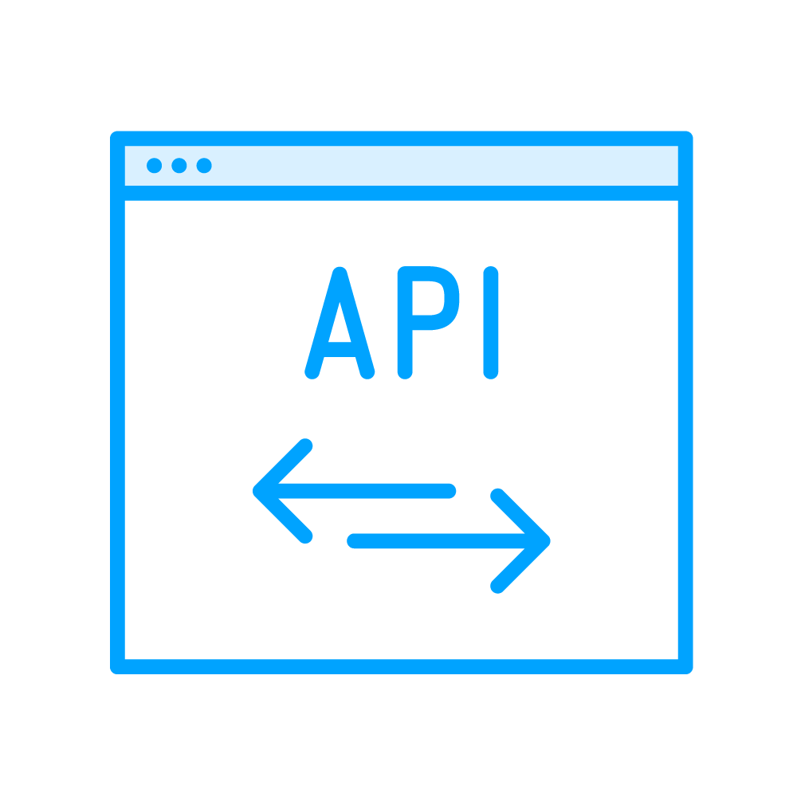


API Testing Use Cases
API-only Testing
(Send Request, Check Response)
API + E2E Testing
(Set state via API, act in UI)
Intercept and mock
(Block or replace Responses)

Slide 3

Overview
HTTP refresher
Request / Response API overview
Monitor network activity
Authenticate via HTTP layer Route API
APIRequestContext
CRUD web API with authentication
Authentication - Setting state using cookies
CRUD operations on the dadjokes API

Slide 4

HTTP is the foundation of data communication for the World Wide Web

Slide 5



GET Request
Response
Client, e.g.:
GET .css
Server
Web browser
Playwright
GET .js

Slide 6

GET Request
Response
Header (metadata)
e.g. Status 200 OK
Status 401 Unauthorized Status 404 Not Found
Body with data (payload)
Some requests have it, some don’t

Slide 7
Other widespread HTTP methods:
GET POST PUT DELETE

Slide 8


Playwright HTTP APIs
Interfaces:
Response
Request
Functions:
status()
allHeaders()
text()

Slide 9

route.abort()
route.fulfill({ status: xxx, body: 'yyy'
});

Slide 10
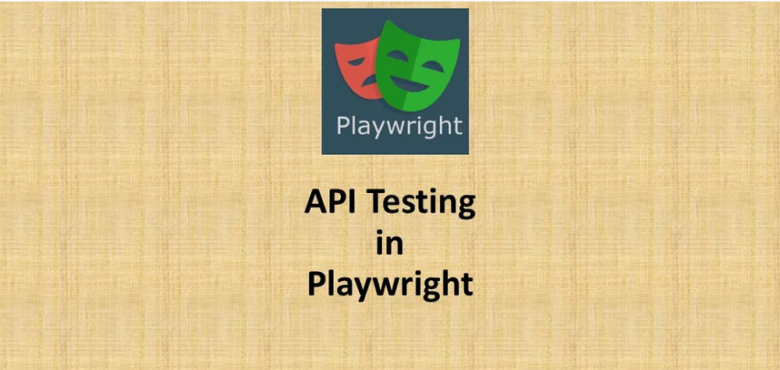
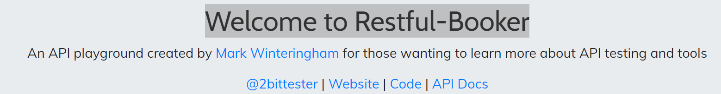

Slide 11
What is APIRequestContext ?
Test your server API.
Prepare server side state before visiting the web
application in a test.
Validate server side post-conditions after running some
actions in the browser.
All of that could be achieved
via APIRequestContext methods.

Slide 12
Scenarios
a. GET :
i. Get all the records
ii. Get the booking details by using query param and assert the
response
b. POST :
i. Create a booking by passing data
ii. Create a booking by passing Json file
c. PUT :
Update booking attributes for an existing resource
and assert the response.
d. DELETE
Finally, we will delete the booking and assert the
response code.

Slide 13
Request / Response
const response = await page.goto(‘’);
// ...
test('...', async ({ request }) => {
const response = await request.get(‘’);
});

Slide 14
page.on('response', response => {
// ...
});
await request.post('url', {
headers: { data: { }
});
},
await page.route('**/*.{js}', route => route.abort());

Slide 15
Up Next:
Understanding Test Results, Logs and Custom Error Handling

